Slide 1
Business Rules,
Decision Management and Smarter Systems
Neil Raden
James Taylor
Notes:
The modern business climate requires smarter systems than most organizations have. Using business rules as a platform for decision management is increasingly recognized as the best way to make your systems smart enough to run your operations. Automating critical operational decisions with business rules, enhancing those rules with data-driven analytics and managing and adapting those decisions over time is what is needed: This approach, enterprise decision management, is the subject of a new book “Smart (Enough) Systems” by the presenters. What you will learn:
Which decisions should you focus on to make your systems smarter.
How rules and analytics come together to automate decisions.
How you get to enterprise decision management from where you are today.

Slide 2
Agenda
Why Smarter Systems
Decisions, decisions, decisions
A Business Rules Foundation
Adding Analytic Insight
Getting to enterprise decision management

Slide 3
Agenda
Why Smarter Systems
Decisions, decisions, decisions
A Business Rules Foundation
Adding Analytic Insight
Getting to enterprise decision management

Slide 4
Why Smarter Systems?
Timeliness
Days
Real-time
Objectives
Local
and clear
Complex
Trade-Offs
Regulations
National and simple
Complex and global
Changes to Strategy
Every 3-5 Years
Constant
Decision-Making
Well-Defined
Increasingly
Complex
Operational Volume
Low
High
Notes:
The need for EDM springs from the growing complexity of the business environment. See if this sounds like the issues your company faces.
Decisions that once might have taken days now have to be made at the speed of the transaction, such as while your customer is completing an online transaction
Business objectives used to be simpler and set at the local level– now those objectives are often set at the corporate level, and involve trade-offs between risk, resource constraints, opportunity costs and other factors
You are being forced to comply with more new regulations, with stricter and more complex rules, shorter deadlines, and with greater consequences for non-compliance
You need to change your decision strategies – such as customer management strategies – more frequently and more rapidly to deal with competitive forces, environmental changes, changes in your customer base, etc.
Decisions that were once “owned” by a single group may now be “shared” by multiple departments, and may have to be coordinated across channels and regions
You used to be able to handle decisions with manual review processes – now the volume makes that impractical

Slide 5

Externalization Requires Smarts
Externalization: Volume + Disparity
Pre-Internet
Internet Age
Retailer
Retailer
Retailer
EDI
Retailer
Retailer
Retailer
Retailer
Retailer
Retailer
Retailer
Retailer
Retailer
Retailer
Retailer
Retailer
Retailer
Retailer
Retailer
Retailer
Retailer
Big
Manufacturer
Retailer
Retailer
Retailer
Supplier
Customer
Partners
Notes:
Businesses used to be able to operate within the confines of their own walls, and when they had to interact on an informational level, there were slaves and masters – one organization controlled the structure and content of the interchange. All of that has changed.
Because of the internet, many parties can participate in an interchange, regardless of their size, location or relative importance to the transaction. The externalization of business as a result of the Internet is creating not only a mountain of data, and vastly more disparity, but also a growing need for more sophisticated ways to deal with it. It is no longer sufficient to gather data and analyze it – action has to be taken. There aren’t enough people and there isn’t enough time to do all of this manually. The data has to be fed to predictive models who’s output is passed to rules engines that take the appropriate action. This is the new calculus for high volume decision-making. It is not just a good idea, it’s derived of necessity.

Slide 6

So What IS A Smarter System
Operational
Real-Time
Rapidly evolving - agile
Learning
Customer-Centric
Extended-Enterprise Ready
Demonstrably Compliant
Notes:
Operational – high performance execution, day to day support of the business, can handle complex real-world situations
Real-Time – not batch, not overnight
Rapidly evolving - agile
Learning – as data accumulates about what works it learns from it
Customer-Centric
Extended-Enterprise Ready
Demonstrably Compliant
In all things, business-driven

Slide 7
Agenda
Why Smarter Systems
Decisions, decisions, decisions
A Business Rules Foundation
Adding Analytic Insight
Getting to enterprise decision management

Slide 8
Smarter Systems Make More Decisions
People
Not Made
Before
Embedded
After
People
Embedded
Not Made
New
Larger boxes represent more decisions, by volume
Notes:
Systems become smarter when they take more decisions for you.
Embedding decisions helps free up people to make New decisions and reduces the number of hidden decisions that no-one is making

Slide 9
More and more decisions can be automated
Expert
Decisions
Value
Manual Decisions
Automated
Decisions
Complexity
Notes:
Rules and analytics are squeezing the range of decisions that need manual decision-makers. Decisions that are:
High-volume
Balancing risk and reward
Customer-facing
Regulated or audited
Multi-channel
Are particularly worth targeting

Slide 10
Different kinds of decisions
High
High-value, low-volume decisions
Medium-value, medium-volume decisions
ECONOMIC IMPACT OF INDIVIDUAL DECISION
Low-value, high-volume decisions
Low
Low High
DECISION VOLUME
Notes:
Decision support is what you need at the left but as you get to the right you need smarter systems that can do a good job of automating these decisions.
What are examples of each kind of decision?

Slide 11

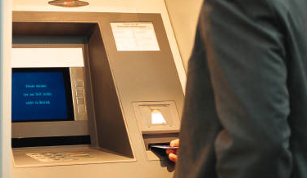


Many Decisions Are Hidden
Notes:
Micro decisions
Organizations do not realize how many they make
Every strategic decision has many operational consequences
Each customer interaction can be many decisions
Manual decisions
Hidden under manual processes
Decisions that are being taken every day by front-line staff
Conflicting decisions
Different parts of your organization treat customers differently
A longer time horizon might drive a different decision
Decisions are made inconsistently
Missing or default decisions
Decisions that you do not think you can take and so you do the same thing every time
The policy was set a long time ago and was never updated

Slide 12
Applications have evolved
User Interface
Browser
Process
Logic
BPM
Enterprise
Database
Data

Slide 13
Evolution Completed
A self-contained, callable service with a view of all the conditions and actions that need to be considered to make an operational business decision
Logic
Decision Services
A service that answers a business question for other services
What is a decision service?

Slide 14
The Basic Process
Identify Decisions
Integrate Decision Services
Automate the decision with business rules
Empower the business to manage the rules
Analytically improve the rules
Add predictive insight
Optimize and adapt

Slide 15
Agenda
Why Smarter Systems
Decisions, decisions, decisions
A Business Rules Foundation
Adding Analytic Insight
Getting to enterprise decision management

Slide 16



Business Rules Are Everywhere
Managed Business
Rules
Policy Manuals
Regulations
Experienced Personnel
Legacy Systems
Historical Data
Notes:
All companies have rules about how to do business in lines of computer code, in manuals and memos, in the employees’ heads, in external regulations, in data. Business rules are simply statements of the way you want to conduct business under different circumstances. Business rules are not a programming concept; they are a business concept. The problem is that they are expressed in many different ways in different places. They can be difficult to find, interpret, update, and enforce.
Rules change…
Because your business policies do
Because your competitors do
Because the law does
Because stock levels do
Because your services and products do
Because your customers do
Because your customers’ needs do
…
So manage business rules

Slide 17
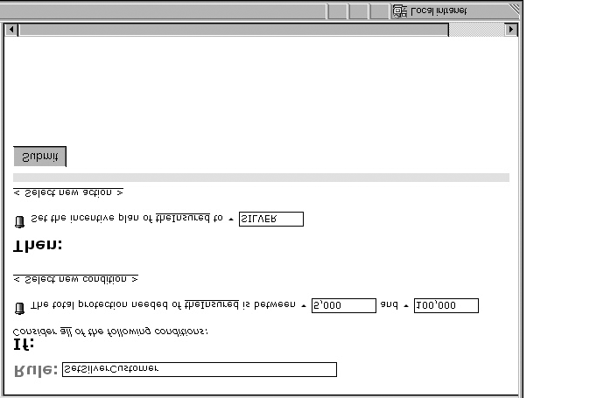
Some Examples
I
f cus
t
ome
r
s debt
’
e
x
c
eeds cus
t
ome
s assets then set the cus
r
’
t
omer's
applic
a
tion st
a
tus
t
o
D
ecline
d
.
I
f o
r
de
r
s pu
’
r
chasedD
a
t
e is ea
r
lier than Janua
y 1, 2004 then p
r
r
i
n
t (
“
Y
our pu
r
chase
is no longer eli
g
ible
f
or
r
etu
r
n
”).
I
f (
v
ehicl
e
s age is be
’
t
w
een 0 and 8
y
ears)
and (poli
c
yholde
r
s age is be
’
t
w
een 21
y
ears and 60
y
ears)
and (poli
c
yholde
s number of claims does not
r
’
e
x
c
eed 3)
then set poli
c
yholde
r
s case
’
t
o
“S
T
AN
D
AR
D
”
< 600
T
r
e
a
tme
n
t Close_
A
cc
ou
n
t
Single
C
600 -750
r
edit
S
t
o
r
e
T
r
e
a
tme
n
t E
x
t
end_
T
e
r
m
> 750
T
r
e
a
tme
n
t
F
o
r
g
i
v
e_
D
ebt
C
a
r
d
T
ype
C
ondition
S
tude
n
t B
r
on
z
e
S
tude
n
t
G
old
S
tude
< USD 900
T
n
t
P
l
a
tinum
r
e
a
tme
n
t Close_
A
cc
ou
n
M
t
a
r
tial
S
t
a
tus
I
n
c
ome
C
ondition
I
n
c
ome Limit
A
c
tion
C
r
edit Limit
A
c
tion
C
r
edit Limit
M
a
A
c
tion
rr
ied
A
cc
ou
n
t Balan
c
e
>= USD 900
T
7,500 - 9,999
1,000
1,500
2,000
r
e
a
tme
n
t
R
edu
c
e_
D
ebt
10,000 - 19,999
1,100
1,600
2,100
< 18
T
20,000 - 29,999
1,200
1,700
2,200
r
e
a
tme
n
t
R
edu
S
epa
rat
ed
A
cc
ou
c
e_
D
ebt
n
t
A
ge
>= 18
T
r
e
a
30,000 - 39,999
1,500
2,200
2,700
tme
n
t Close_
A
cc
ou
n
t
40,000 - 49,999
2,000
2,500
3,000
50,000 - 59,999
2,500
2,800
3,300
60,000 - 69,999
3,500
3,800
4,000
70,000 - 79,999
4,000
4,500
4,800
80,000 - 89,999
4,500
4,700
5,200
90,000 - 99,999
5,000
5,200
5,700
Smart (Enough) Systems, Prentice Hall June 2007. Fig 4.3

Slide 18
Empower the Business to Manage the Rules
I want to relax my underwriting policy
I want to be able to promote a new product combination
So you business-types want to be able to change your business rules?
I need to add the new regulations
No…
Notes:
Rule maintenance must be:
A business function
Familiar
Integrated
Secure & controlled

Slide 19
Which Would Your Users Understand?
public class Application {
private Customer customers[];
private Customer goldCustomers[];
...
public void checkOrder() {
for (int i = 0; i < numCustomers; i++) {
Customer aCustomer = customers[i];
if (aCustomer.checkIfGold()) {
numGoldCustomers++;
goldCustomers[numGoldCustomers] = aCustomer;
if (aCustomer.getCurrentOrder().getAmount() > 100000)
aCustomer.setSpecialDiscount (0.05);
}
}
}
If customer is GoldCustomer
and Home_Equity_Loan_Value is more than $100,000
then college_loan_discount = 0.5%
College Loan Discounts
Current Discount =
%
Eligibility
Gold Customer
and
Home Equity Loan
more than
$100,000
Smart (Enough) Systems, Prentice Hall June 2007. Fig 6.8

Slide 20
Agenda
Why Smarter Systems
Decisions, decisions, decisions
A Business Rules Foundation
Adding Analytic Insight
Getting to enterprise decision management

Slide 21
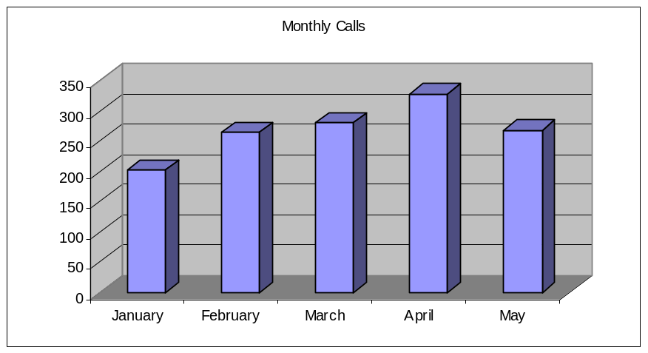
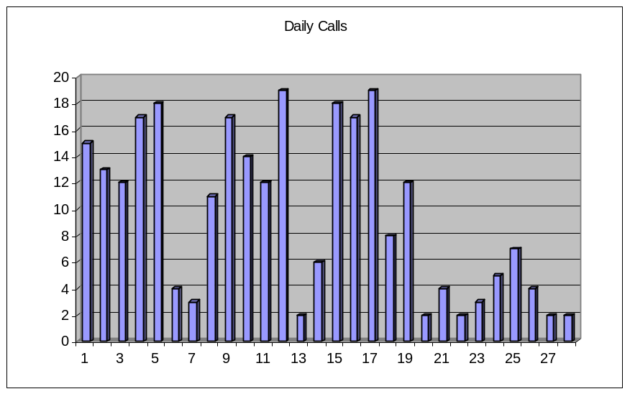
Analytics <> Graphs
Even graphics require interpretation
Not everyone can see the patterns
And code does not “see” at all
Smart (Enough) Systems, Prentice Hall June 2007. Fig 9.3

Slide 22
More Sophisticated Analytics Improve Results
Descriptive Analytics
Predictive Modeling
Decision Optimization
Specialty
Response
Score
Margin
*
*
*
*
*
Region
Prescription
Volume
Net Revenue
per Rx
*
*
*
*
*
*
*
*
*
*
*
Previous
Rx
Call
Plan
Total Calls
Cost
*
*
*
*
*
*
*
*
*
*
*
*
Cost for
each call
*
*
*
*
*
*
# Samples
Profit
*
Census
Data
*
*
*
*
*
*
*
Total Sample
Cost
*
*
*
*
*
*
*
*
Cost of
Goods Sold
*
*
*
*
*
Unit Sample
Cost
Distribution
Cost
How do I use data to learn about my customers? Who are my best/worst customers?
How are those customers likely to behave in the future? How do they react to the myriad ways I can “touch” them?
How do I leverage that knowledge to extract maximum value from my marketing investments?
Knowledge - Description
Action - Prescription
Notes:
The analytics in an EDM take different forms, but often emerge in organizations sequentially, from descriptive to the predictive. When people gain facility with these tools, they are ready for the next step, which is to combine multiple models into powerful decision models.
The continuum of learning goes from gaining knowledge through the examination and description of data, to understand the cause and effects to building simulations of real-life events with the purpose of automating the decisions.

Slide 23
Descriptive Analytics - Improve Rules
Use: Find the relationships between customers
Example: Sort customers into groups with different buying profiles.
Operation: Analysis is generally done offline, but the results can be used in automated decisions – such as offering a given product to a specific customer
High
Income
High income,
low-moderate education
Low-moderate
income, young
*
*
*
*
Moderate-high education
low-moderate income
*
*
*
*
*
*
*
*
*
*
*
*
*
*
*
*
*
*
*
*
*
*
*
*
*
*
*
*
*
*
*
*
*
Education
High
*
*
*
*
*
Age
*
*
*
*
*
*
*
*
*
*
*
*
Moderate education,
low income, middle-aged
*
High
Low education,
low income
© Fair Isaac Corporation, reproduced with permission
Notes:
Descriptive analytics can be used to categorize customers into different categories – which can be useful in setting strategies and targeting treatment.
But not just to your analysts, also to your systems. Delivering these models as rules is often key.

Slide 24
Predictive Analytics – Add Insight
Use: Identify the odds that a customer will take a specified action
Example: Will the customer pay me back on time? Will the customer respond to this offer?
Operation: Models are called by a business rules engine to “score” an individual or transaction, often in real time
230
210
190
170
Good Customer
“Bad” Customer
© Fair Isaac Corporation, reproduced with permission
Notes:
Predictive analytics often rank-order individuals. For example, credit scores rank-order borrowers by their credit risk – the higher the score, the more “good” borrowers for every “bad” one.
The risk or opportunity in the context of a single customer or transaction
Not an overall pattern, even if it is predictive
Executable
Timeliness, accuracy, operationalization, horizon

Slide 25
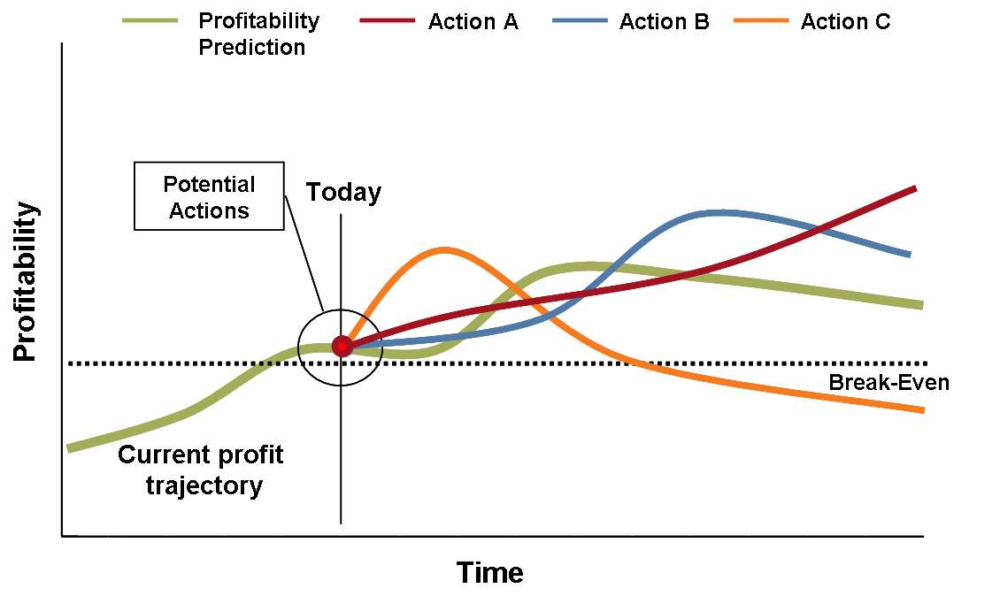
Impact May Take Time to Play Out

Slide 26
What Is Champion/Challenger Anyway?
Unknown
Optimal Approach
Unknown
Optimal Approach
Decision Space
Considered
Single Approach
Champion
Decision Space
Considered
Challenger 2
Challenger 1
Notes:
Champion-Challenger
Try new approaches
Evaluate performance
Promote success

Slide 27
Analytics To Optimize And Adapt
Use: Design a ruleset that will deliver the right decisions to reach goals
Example: Identify how much money to spend on each marketing channel to maximise sales in a given timeframe and budget
Operation: Decision models are used offline to develop rules, which can then be deployed to operate in real time
Margin
Response
Score
Specialty
Net Revenue
per Rx
Region
Prescription
Volume
Previous
Rx
Total Calls
Cost
Call
Plan
Census
Data
# Samples
Cost for
each call
Profit
Cost of
Goods Sold
Total Sample
Cost
Input
Action
Reactions / Factors
Objective
Unit Sample
Cost
Distribution
Cost
© Fair Isaac Corporation, reproduced with permission
Notes:
Decision Analytics maps the relationships between the data available, the decision itself, the outcomes of the decision and the business objective. It is ideal for balancing multiple objectives and constraints.
Managing tradeoffs between multiple models like risk of returning a product and the likelihood of purchasing it
Trying to find the best rules, given all your models

Slide 28
Agenda
Why Smarter Systems
Decisions, decisions, decisions
A Business Rules Foundation
Adding Analytic Insight
Getting to enterprise decision management

Slide 29
The Approach
ENTERPRISE DECISION MANAGEMENT
is an approach that automates, improves & connects decisions
to enhance business performance
Automate, Improve & Connect
  Automate for speed and consistency
  Improve targeting, relevance and results
  Connect decisions across functions, channels, customer touchpoints
Enhance Business Performance
  Increase customer profitability
  Grow and strengthen customer relationships
  Reduce fraud and credit risk
  Lower costs of making decisions
Notes:
Increase customer profitability through more effectively meeting customer needs
Higher cross-sell and response rates via better Marketing decisions
Lower customer churn via better Customer Management / Service decisions
Increase operating effectiveness via lower risks and costs
Lower credit risks, e.g. reduce bad debt via better Originations, Customer Management and C&R decisions
Lower operating risks, e.g. identifying and eliminating fraudulent transactions
Reduce labor costs associated with making decisions and related exception processing

Slide 30
Putting The Pieces Together
Data
Warehouse
Predictive Analytics
Predictive
Model
Rules
Rules
Decision
Service
Production
Application
Business
Rules
Predictive
Model
Enterprise IT Infrastructure
Rules
Adaptive
Control
Operational
Data Store
Smart (Enough) Systems, Prentice Hall June 2007. Fig 5.1

Slide 31

The Evolution Of A Retention Offer
< 600
600 -750
T
r
e
a
tme
n
t Close_
A
cc
ou
n
t
Single
C
r
edit
S
t
o
r
e
T
r
e
a
tme
n
t E
x
Automate Decision
Apply rules
Segment customers
Predict risk, value
Optimize decision
> 750
M
a
r
tial
S
t
a
tus
M
a
rr
ied
A
cc
ou
n
t Balan
c
e
< USD 900
>= USD 900
S
epa
rat
ed
A
cc
ou
n
t
A
ge
< 18
>= 18
http://www.f
Web
*
*
*
*
*
*
*
*
*
*
*
*
*
*
*
*
*
*
*
*
*
*
*
*
*
*
*
*
*
*
*
*
*
*
*
*
*
*
*
*
*
*
*
*
*
*
*
*
*
*
Call Center
*
*
*
*
*
Email
Mobile
Specialty
Response
Score
Margin
Region
Prescription
Volume
Net Revenue
per Rx
Previous
Rx
Call
Plan
Total Calls
Cost
Census
Data
# Samples
Cost for
each call
Profit
Cost of
Goods Sold
Total Sample
Cost
Distribution
Cost
Unit Sample
Cost
Notes:
A typical retention scenario has multiple channels with different systems and platforms with a high risk of inconsistency
First step is to focus on the retention decision as a decision and then automate it with a decision service
Clearly building it with rules makes it more flexible, more agile, more business-centric
But there are many different kinds of customers for whom different offers make sense so analytically derive some rules to segment and target customers
Historical data is available that might allow us to predict future value, such as likelihood to use a profitable optional service, so let’s integrate that and add rules to take advantage of it
Finally have multiple models or risk and benefit and so can model and optimize the decision.

Slide 32
An overview of traversing the steps in EDM
Readiness Assessment
Phase 1 - Piecemeal
First
Rules
Project
First
Analytic
Project
Phase 3 - Expansion
Overlapping and
Adjacent Projects
Manage
Scenarios
Broaden
Analytic Base
Foundation
Improved Foundation
Phase 2 – Local Decision Management
Rules and
Analytics
Champion
Challenger
Steady State EDM
Enterprise
Management
Analytic
Value Chain
Optimization
and What If
Enterprise
Backbone
Smart (Enough) Systems, Prentice Hall June 2007. Fig 9.1

Slide 33
Action Plan
Identify your decisions
  Decisions that matter to customers
  Hidden decisions
  Transactional decisions
Consider
  Who takes them now
  What drives changes in them
  What the context is for them
Adopt Business Rules
  The approach and the technology
  Management and governance
  Change the relationship between business and IT
Investigate Data Mining and Predictive Analytics
  Data Mining for rules
  Predictive reporting in applications
  Executable analytics
Build Adaptive Control into your applications

Slide 34
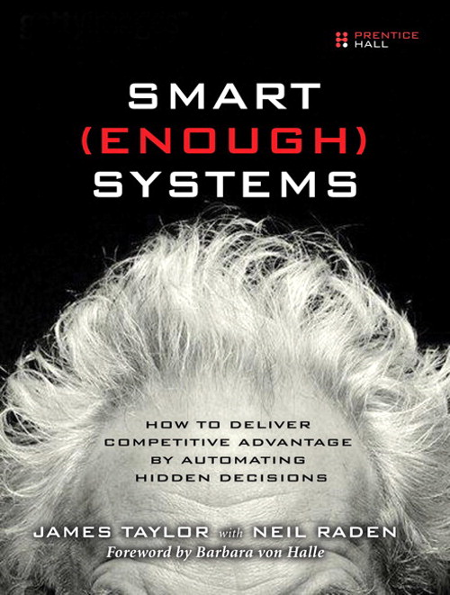
Smart (Enough) Systems – The Book
The book is full of insightful examples of problems solved by applying Enterprise Decision Management across various industries and outlines a practical and incremental method for implementing the technology.
How key business trends impact the decision-making process
Why organizations need systems smart enough to cope with these trends
How decision automation can make their systems smart enough
How to translate decisions into a corporate asset and competitive advantage
The ROI and business impact of better decisions and smarter systems
The core concepts and technologies needed and how they work together
JUNE 2007 – ISBN: 0132347962

Slide 35
Smart (Enough) Systems
A masterful presentation of an important new idea, Enterprise Decision Management (EDM). With Enterprise Decision Management (EDM), business rules finally have a compelling architectural voice and clear business motivation.
Ronald G. Ross
If your business needs to make quick, accurate decisions on an industrialized scale, you need to read this book.
Thomas H. Davenport, Author of “Competing on Analytics”
James Taylor and Neil Raden are on to something important in this book – the tremendous value of improving the large number of routine decisions that are made in organizations every day.
Dr. Hugh J. Watson, University of Georgia
This book shows how to use proven technology to make business processes smarter. It clearly makes the case that organizations need to optimize their operational decisions. It is a must-have reference for process professionals throughout your organization.
Jim Sinur, Chief Strategy Officer, Global 360, Inc.
Smart (Enough) Systems overcomes the jargon and hype of business rules by reframing the challenge as the strategic necessity to control decisions. It should be on every thoughtful manager’s bookshelf
Tom Debevoise, author of Business Process Management With a Business Rules Approach
http://www.smartenoughsystems.com

Slide 36
Thank You
James Taylor | Neil Raden
james@smartenoughsystems.com | neil@smartenoughsystems.com
http://www.smartenoughsystems.com

